Slide 1


11+ Systems {insert_name_here}
Mrinal Vashisth
PhD Year 2, Computational Psychometrics, TSU, RF
M.Sc. Human Development: Genetics, Neuroscience and Psychology, TSU, RF
M.S. Applied Mathematics and Information Technology (Systems Biology and Bioinformatics), ITMO, RF
B.Tech. Biotechnology, JNU, RI

Slide 2
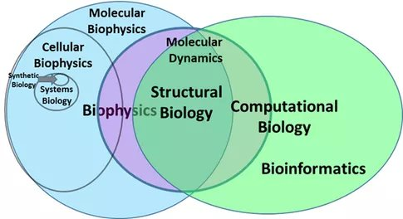
Creating hypothetical jobs 101
https://www.quora.com/What-is-the-major-difference-between-biophysics-and-structural-biology
https://marekbennett.com/tag/paul-lockhart/

Slide 3

Moral of the story:
Quora should be made illegal
Nobody really understands anything and it is Spider-Man blaming Spider-Man

Slide 4
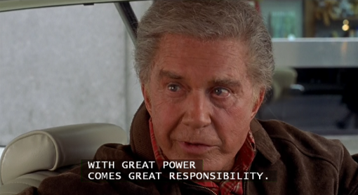

Slide 5
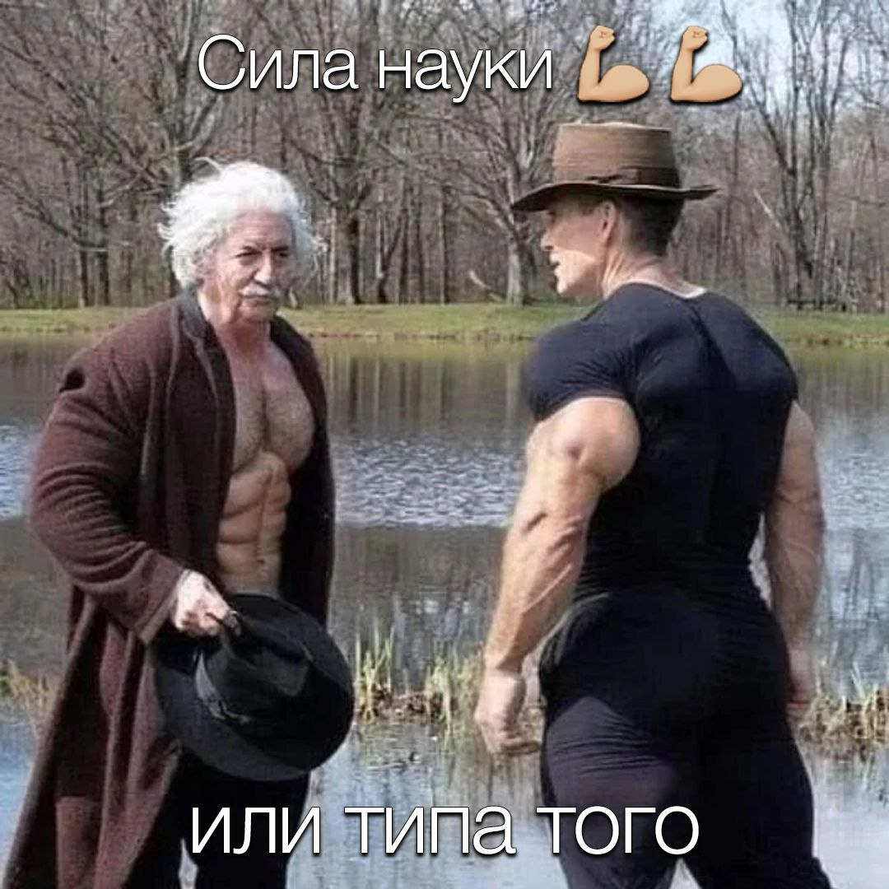
Go to Jupyter notebook 11

